Slide 1
Linked List

Slide 2
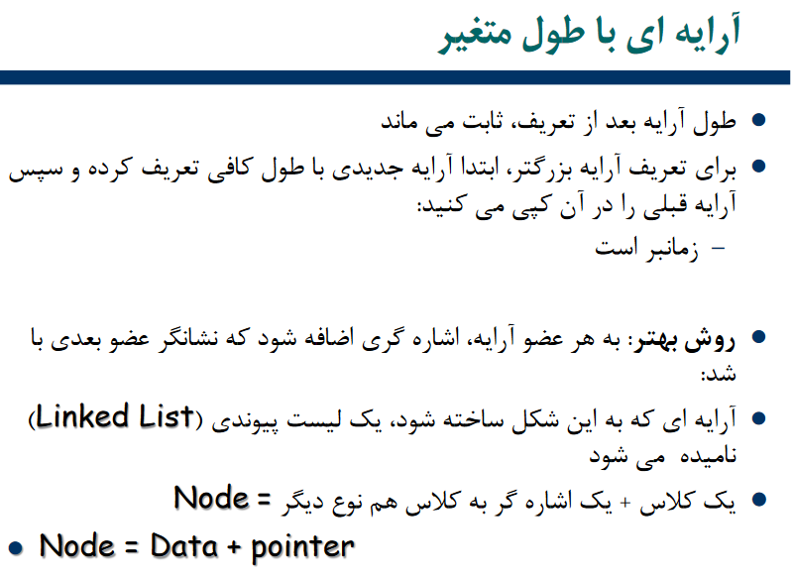

Slide 3
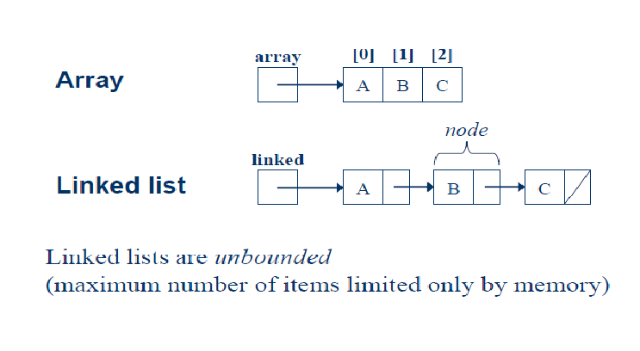

Slide 4
Linked List
A Linked List is a linear data structure which looks like a chain of nodes, where each node is a different element. Unlike Arrays, Linked List elements are not stored at a contiguous location.
It is basically chains of nodes, each node contains information such as data and a pointer to the next node in the chain. In the linked list there is a head pointer, which points to the first element of the linked list, and if the list is empty then it simply points to null or nothing.

Slide 5
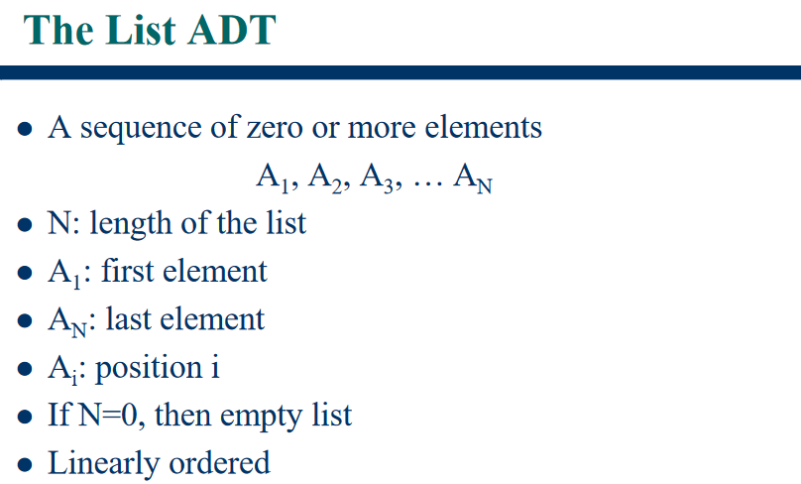

Slide 6
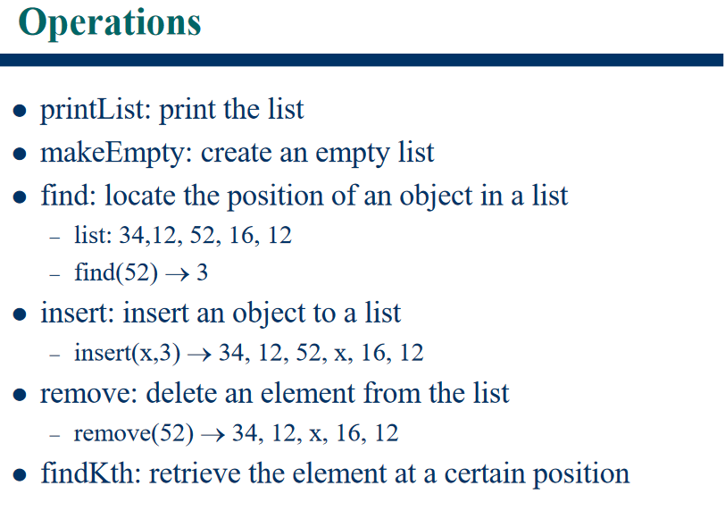

Slide 7
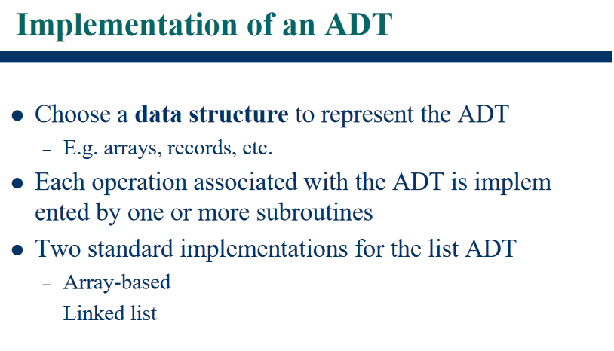

Slide 8
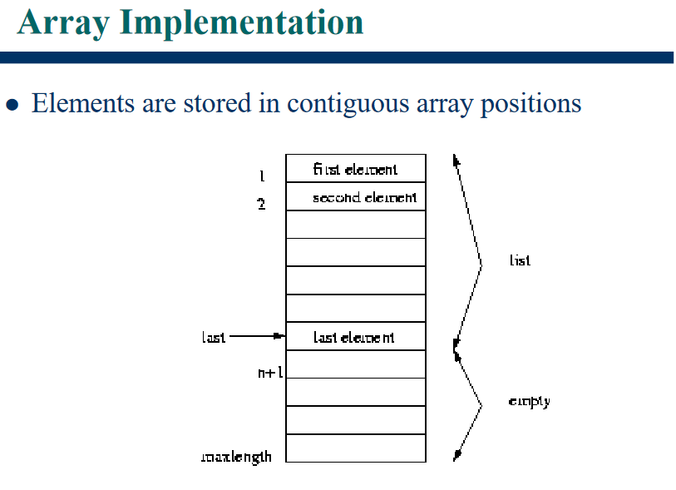

Slide 9
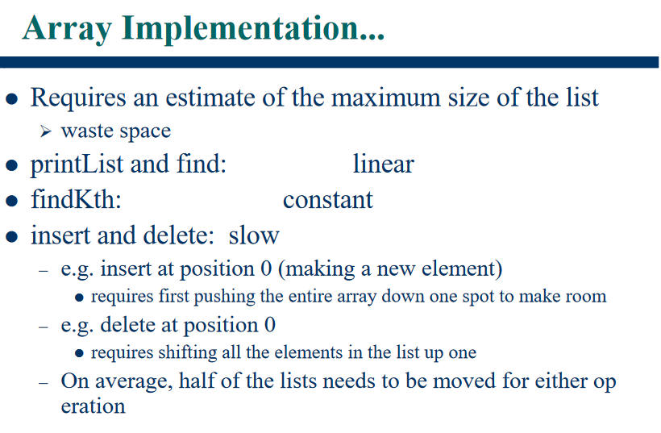

Slide 10
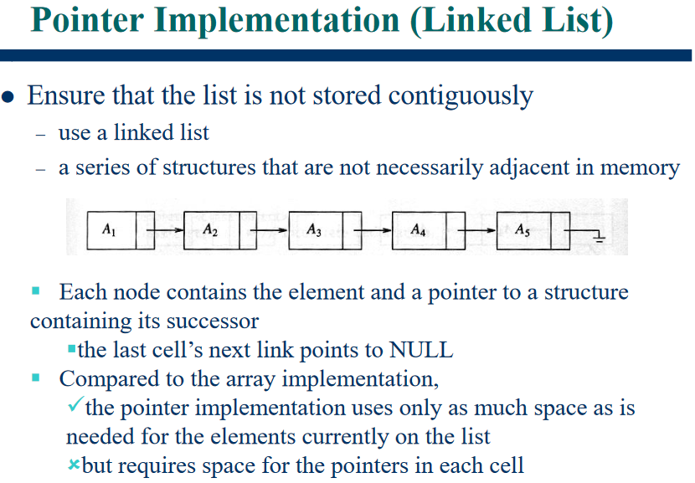

Slide 11

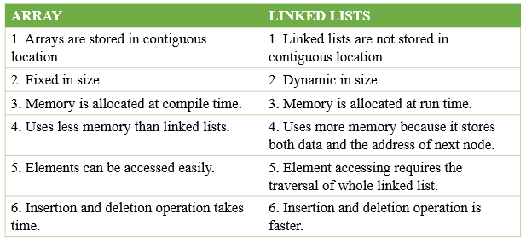

Slide 12
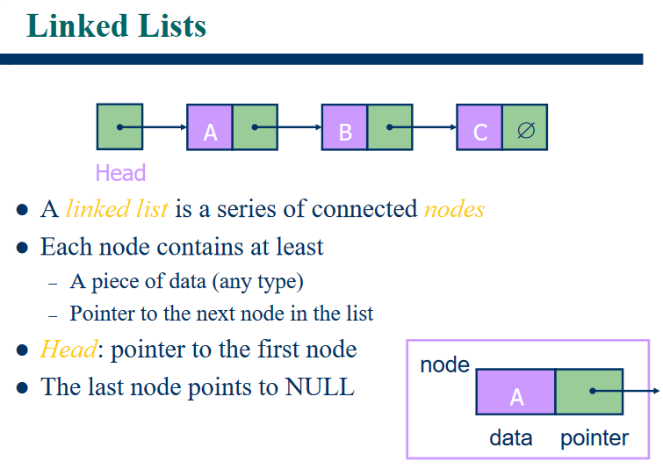

Slide 13
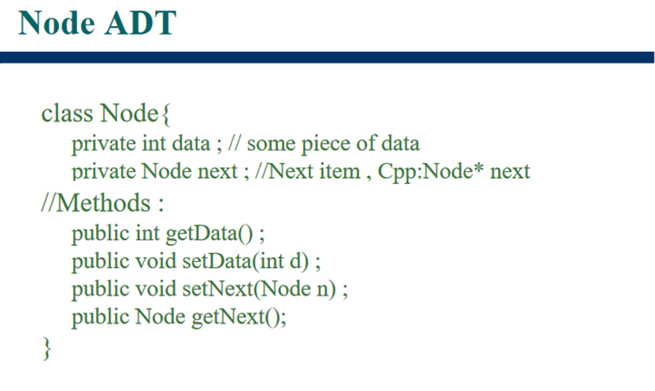

Slide 14
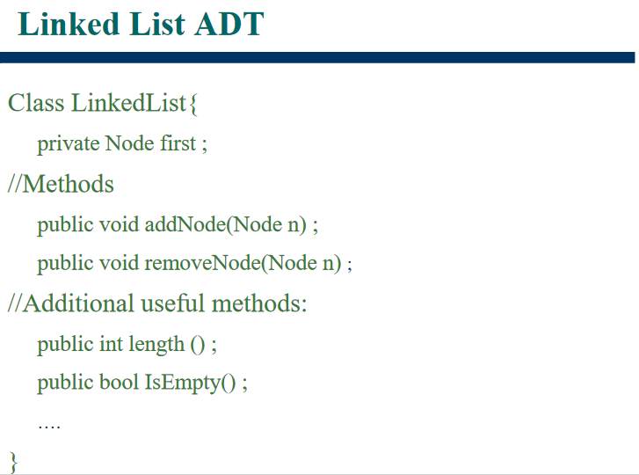
head ;

Slide 15
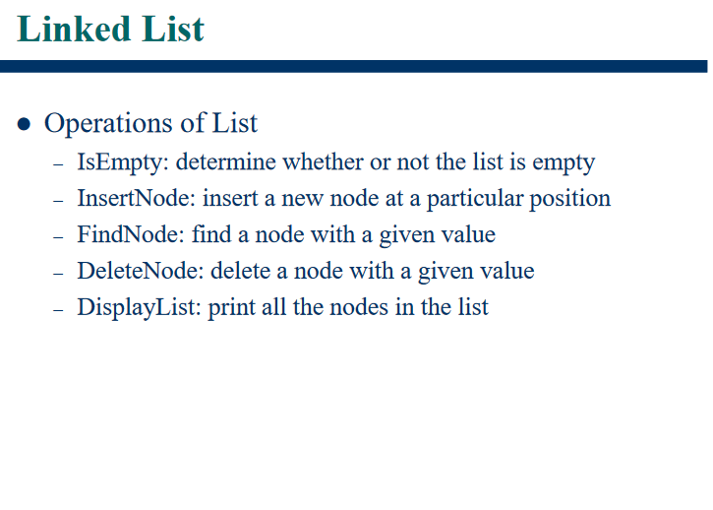

Slide 16
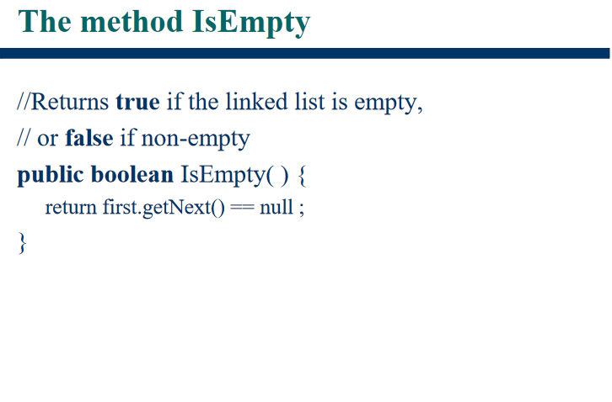
head.getNext() == null;

Slide 17
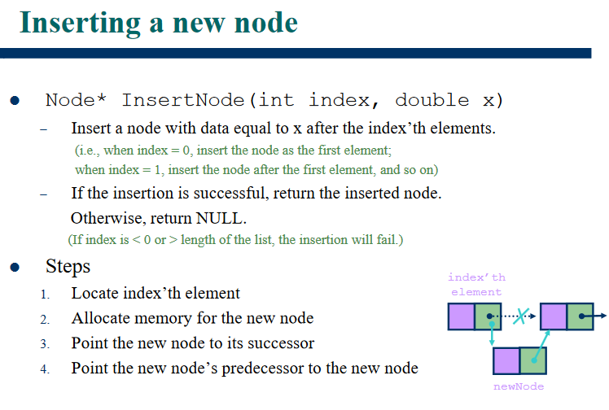

Slide 18
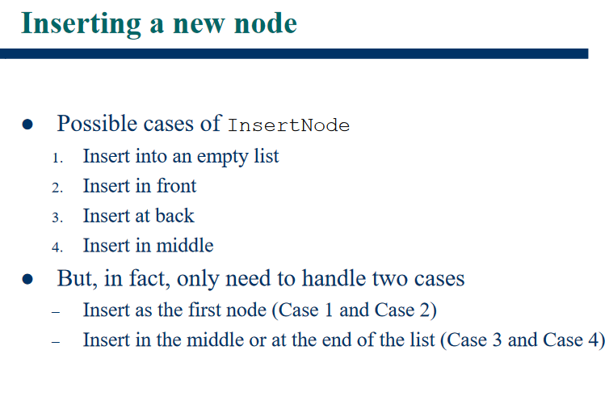

Slide 19
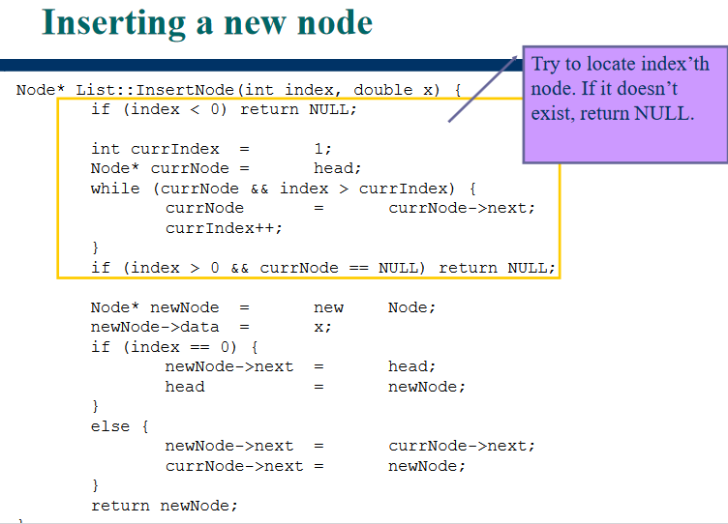

Slide 20
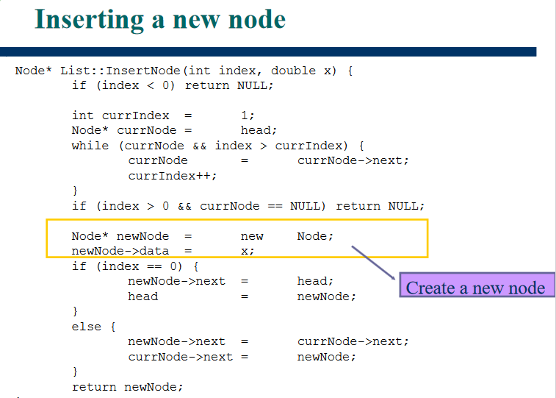

Slide 21
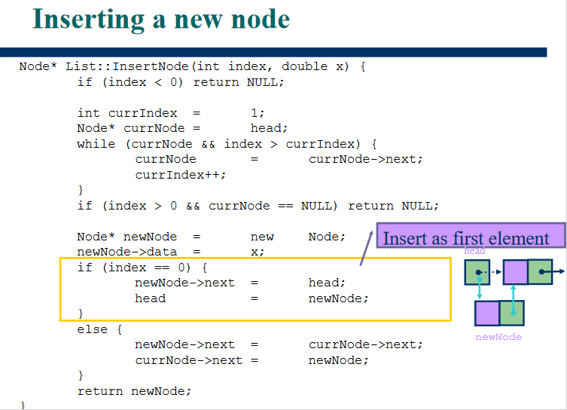

Slide 22
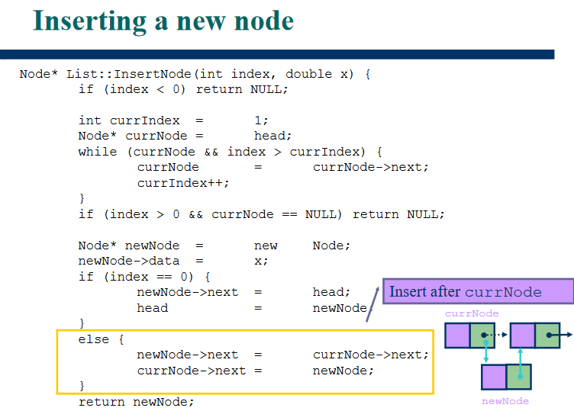

Slide 23
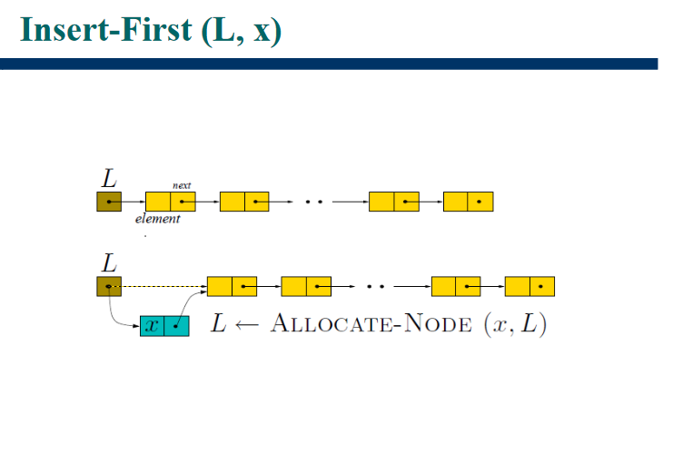

Slide 24
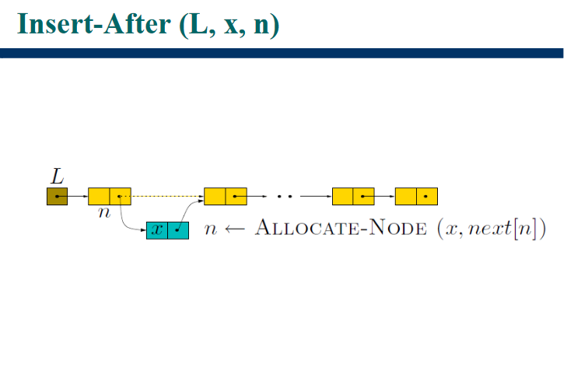

Slide 26
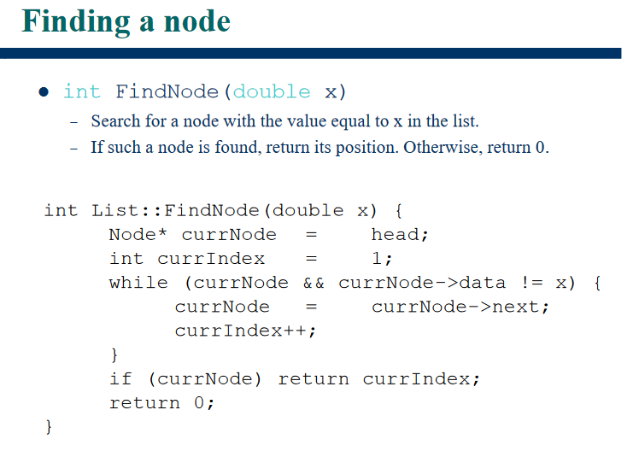

Slide 27
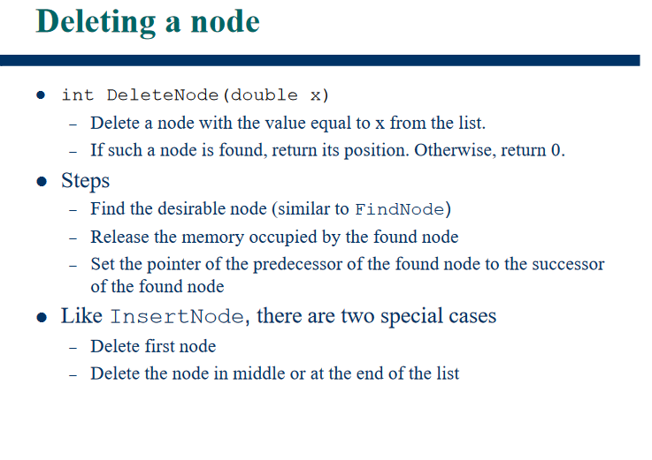

Slide 28
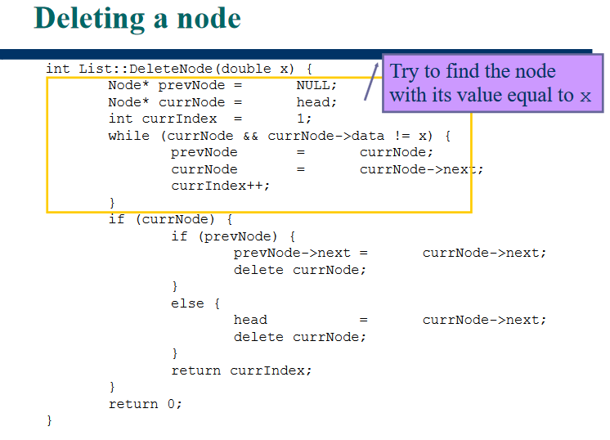

Slide 29
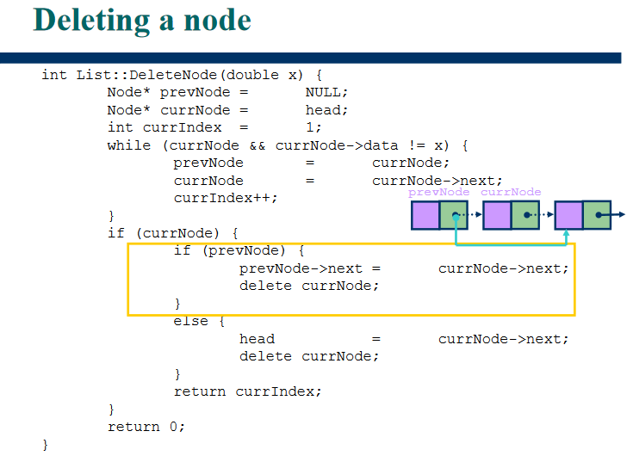

Slide 30
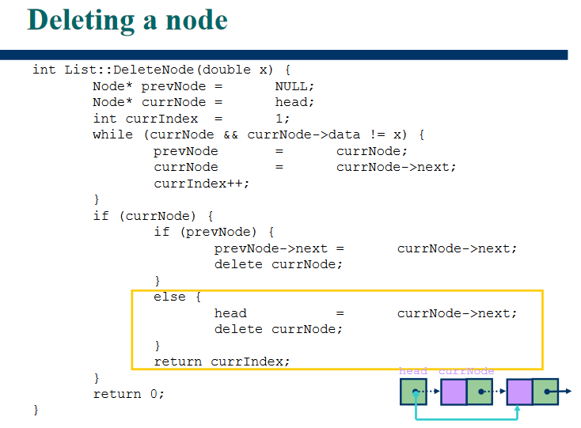

Slide 31
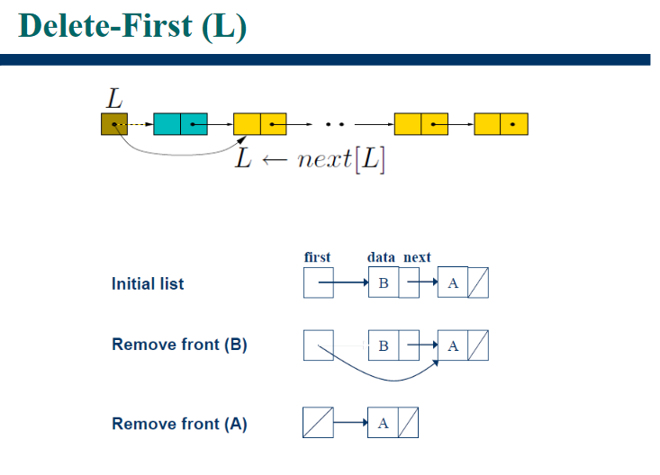

Slide 32
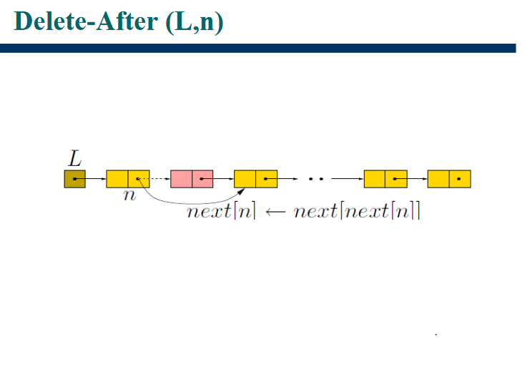

Slide 33
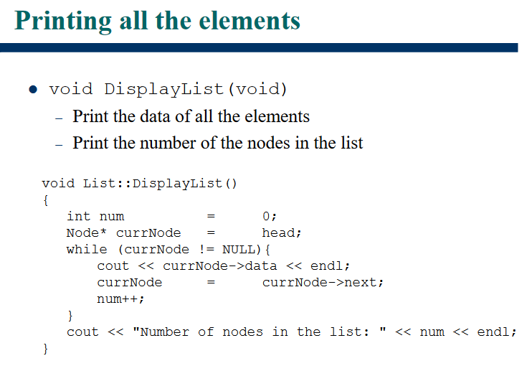

Slide 34
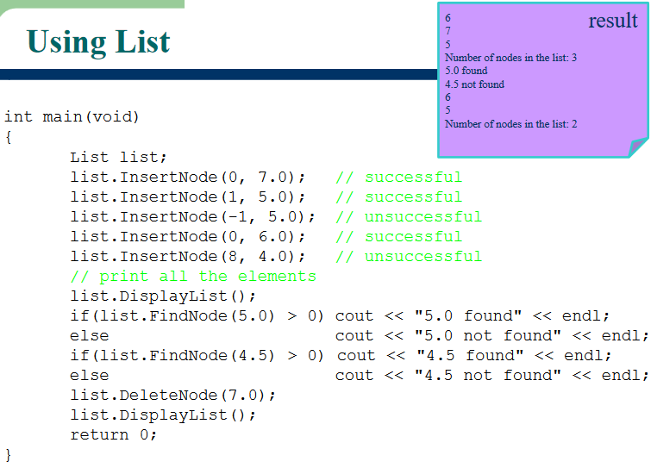

Slide 35
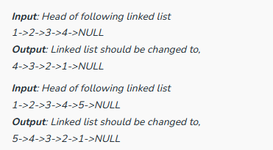
How to Reverse the Linked List?

Slide 36
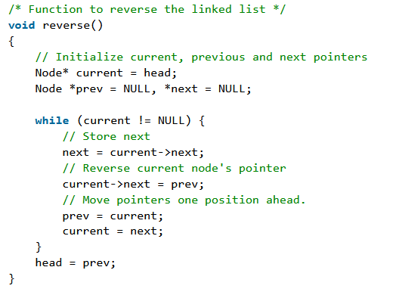
How to Reverse the Linked List?

Slide 37
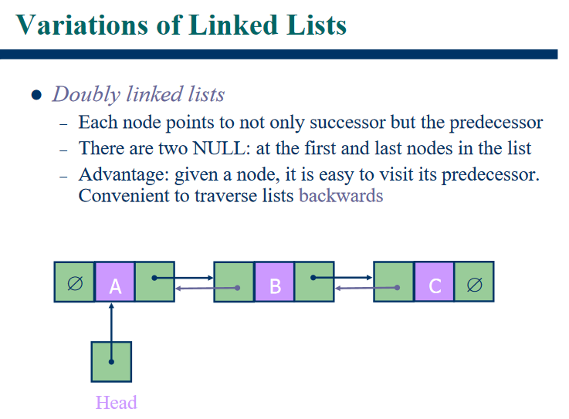

Slide 38
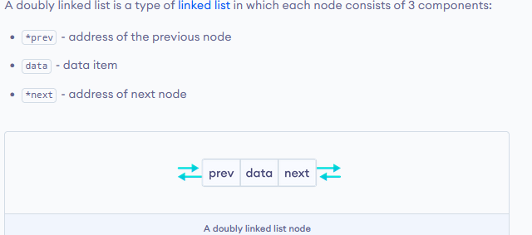
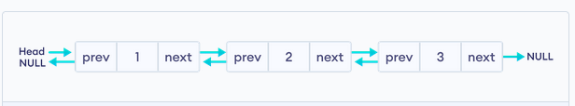
Doubly Linked List
A doubly linked list (DLL) is a special type of linked list in which each node contains a pointer to the previous node as well as the next node of the linked list.

Slide 39
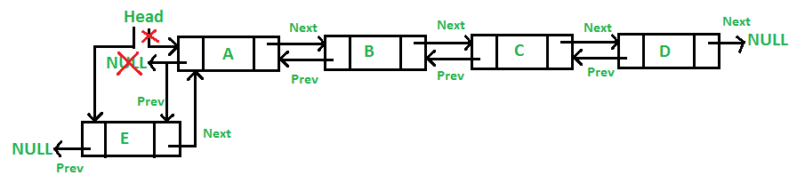
Doubly Linked List – Insertion at the front
The new node is always added before the head of the given Linked List. The task can be performed by using the following 5 steps:
Firstly, allocate a new node (say new_node).
Now put the required data in the new node.
Make the next of new_node point to the current head of the doubly linked list.
Make the previous of the current head point to new_node.
Lastly, point head to new_node.

Slide 40
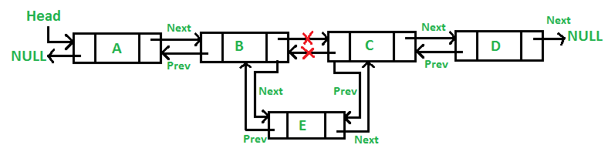
Doubly Linked List – Insertion after given node
We are given a pointer to a node as prev_node, and the new node is inserted after the given node. This can be done using the following 6 steps:
Firstly create a new node (say new_node).
Now insert the data in the new node.
Point the next of new_node to the next of prev_node.
Point the next of prev_node to new_node.
Point the previous of new_node to prev_node.
Change the pointer of the new node’s previous pointer to new_node.

Slide 41
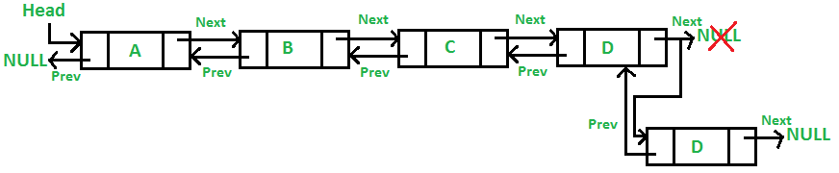
Doubly Linked List – Insertion at the end
The new node is always added after the last node of the given Linked List. This can be done using the following 7 steps:
Create a new node (say new_node).
Put the value in the new node.
Make the next pointer of new_node as null.
If the list is empty, make new_node as the head.
Otherwise, travel to the end of the linked list.
Now make the next pointer of last node point to new_node.
Change the previous pointer of new_node to the last node of the list.

Slide 42
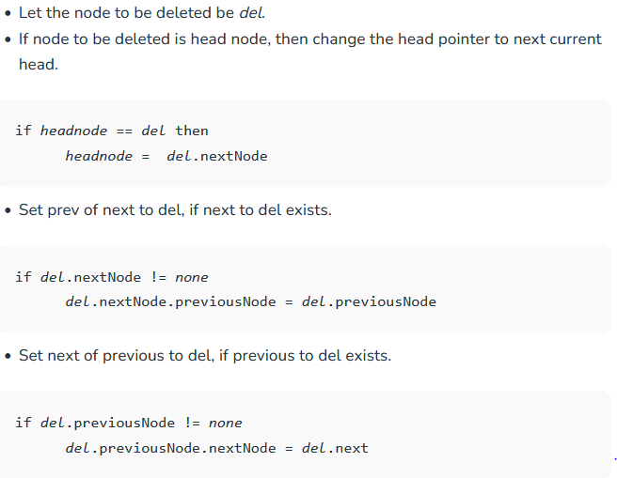
Doubly Linked List – Deletion

Slide 43
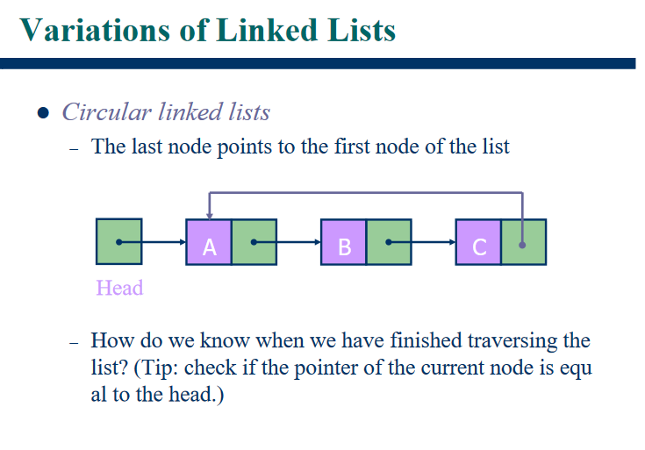

Slide 44

Circular Linked List
The circular linked list is a linked list where all nodes are connected to form a circle. In a circular linked list, the first node and the last node are connected to each other which forms a circle. There is no NULL at the end.

